Slide 1
WHITE STATION ELEMENTARY
2020-2021 SCHOOL REENTRY PARENT VIRTUAL MEETING
JULY 24, 2020

Slide 2
Our Norms
Be present
Use video feature
Be Solution Oriented
Mute Mic During Presentation
Use chat feature for questions during the meeting

Slide 3
Purpose & Outcomes
Purpose
Outcomes
Ask questions to better understand the SCS & WSE plans for school reentry
Offer thoughtful suggestions that will help enhance the plan for school reentry
Review plans for returning to school to gain better clarity about school reentry
Provide available answers to questions asked
Capture unanswered questions to share with SCS and/or adjust plan

Slide 4
We are WSE Leaders!
Every student is invested
Every staff member has a positive impact
Every family is engaged
Every community member is connected

Slide 5
General Overview
The 2020-21 school year will begin August 31 for all students.
2 options for beginning school in August (Virtual or In-Person)
Make selection in Power School (Committed through 1st semester)
Face Masks must be worn by all children & adults in the building at all times
Faculty, staff, and Students with 100.4+ temp cannot attend school until cleared
Currently we have ELOP for before and after KK-5th/Y-Care as our PreK aftercare program provider
After-School activities will have to be decided per each activity for safety
Field Trips are canceled through the 1st semester

Slide 6
Building Safety Measures
Minimum furniture will be in the classroom to maximize space
*Currently about 14 – 18 children can socially distance in a classroom depending on grade level and classroom
Floor decals are being provided by SCS to help children maintain social distance in hallway
Additional signs in hallways, restrooms, etc.
Stop signs throughout building strategically placed to help line leaders know where to go and stop
Hand Sanitizing stations will be strategically placed to ensure that high traffic areas are safe.
Isolation room monitored by WSE staff if one of our children becomes ill during the day.
Aramark staff clean high traffic areas and restrooms throughout the day
Daily deep clean/disinfecting of all classrooms each day after building is cleared

Slide 7
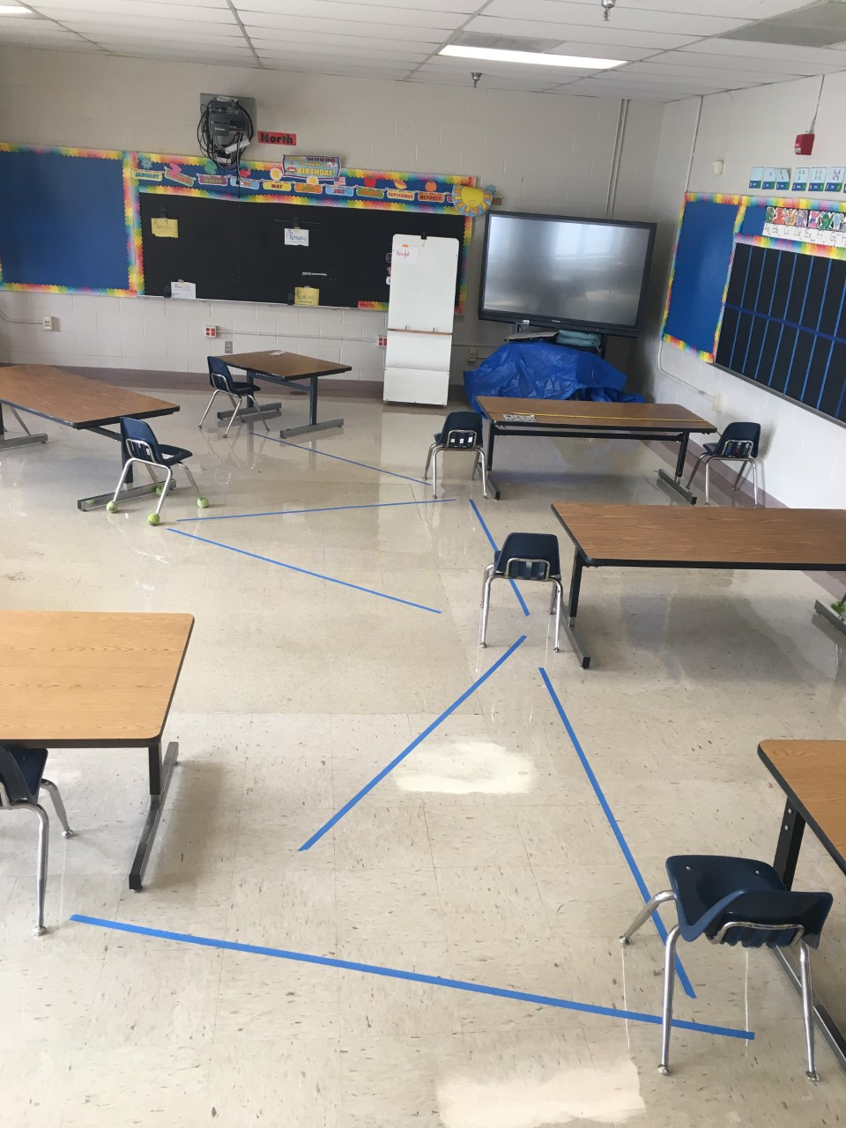
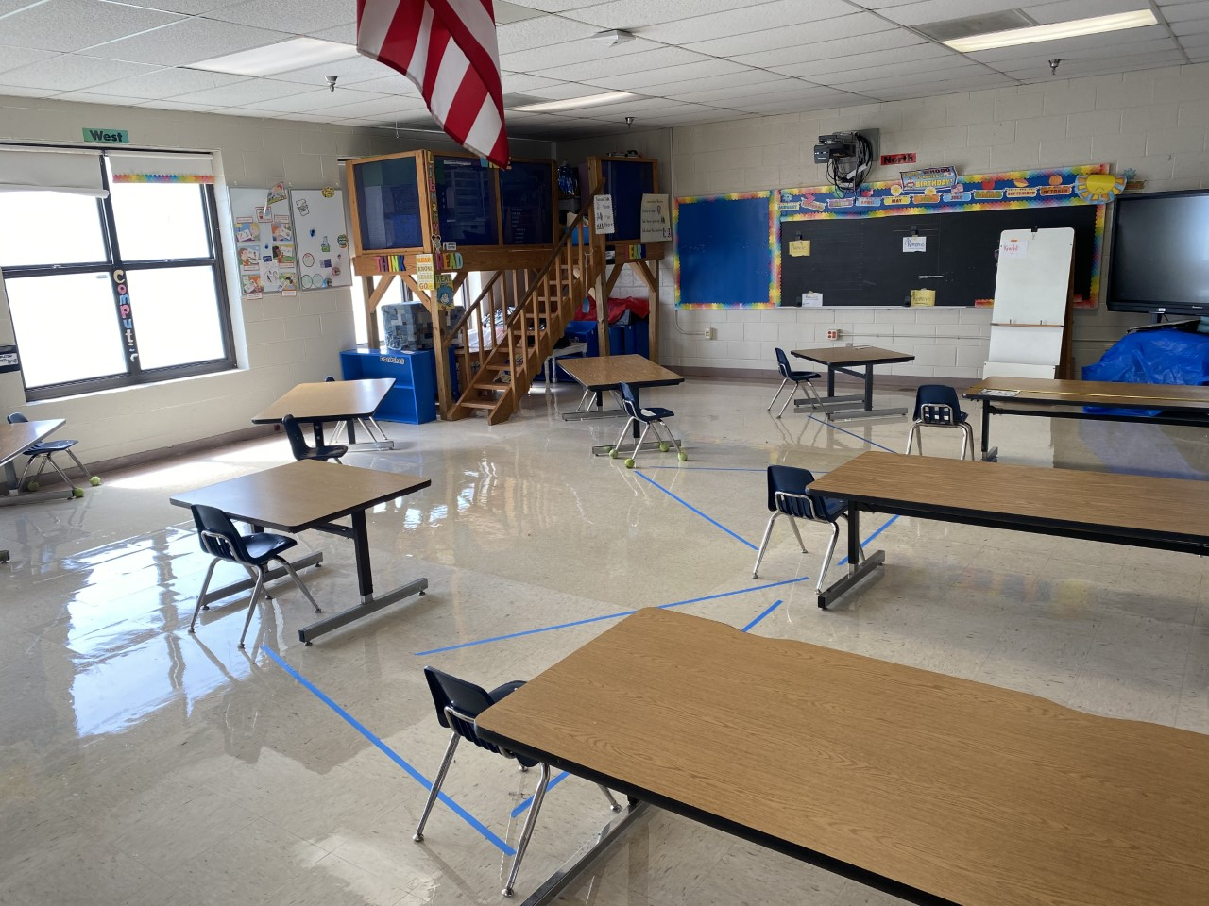
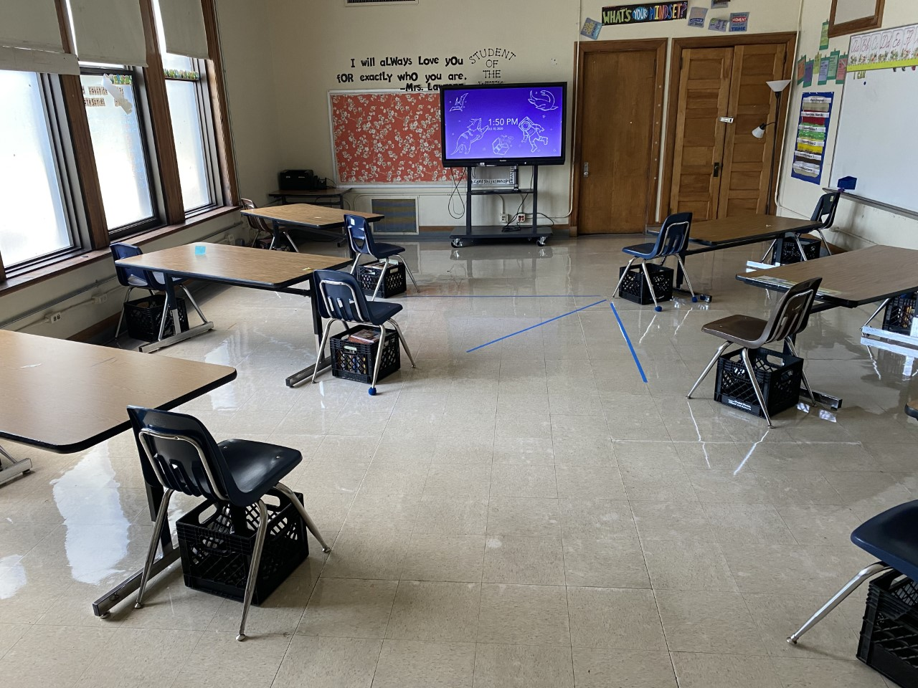

Slide 8
COVID 19 Exposure
When a school experiences exposure to the virus, the District will consult with public health officials to determine if the school needs to close completely or if a portion of the school needs to be blocked off for deep cleaning.
When schools close, all students will learn virtually on the device provided to them with Microsoft Teams and their classroom teacher.
Principals will advise teachers and parents of the daily virtual learning schedule should the school have to close.
Teachers will provide live instruction each day, provide and grade assignments, etc., just as they would in a regular school day.

Slide 9
In-School Operations
Temperature checks for all students and staff before entering building
All students and staff wear masks/face guards during the school day
Sanitizing stations throughout the building
Limited transitions for students
Cohorts of students use specific routes in the building
Cubby areas will not be utilized
Minimal use of cafeteria for breakfast and lunch
Remaining lunchroom classes will occur in classroom or outside when possible
No sharing of school supplies
Arrival/Dismissal procedures altered to social distance
Floor decals and wall signage to show students social distancing guidelines throughout the building
ELOP Before & After Care/ Y-Care After Care (Time TBD)

Slide 10
In-School Instruction
Regular School Day 8:15 – 3:15
Students are responsible for submitting assignments on time as specified by the teacher
Grades and student feedback will be given weekly
Homework will be assigned weekly
Microsoft TEAMs and CLEVER will be used daily during instruction (ensure all students are familiar with online instruction)
Students will have access to virtual content as necessary (i.e. recorded lessons, resources, etc.)

Slide 11
Virtual School Operations
Devices provided by SCS for all students with expectations for usage & care
Attendance to all assigned virtual classes is mandatory
Virtual assignments are submitted weekly
Parents may need to assist students with logging in (primary students may need more assistance)
WSE will have an in-house technology team to assist parents with technology issues

Slide 12
Virtual Instruction
ELA – 2 hours (Teacher Led Instruction)
45 min (30 min reflective writing, 15 min reading daily)
Math – 1 hour
Science – 30 min (M/W/F)
Social Studies – 30 min (T/Th)
Intervention – 45 min *iReady
Support Classes – 30 min
*Instructional times are per day (see pg. 25 of Reentry Plan)

Slide 13
Virtual Instruction
WSE teachers will provide Virtual Instruction for WSE children
Students will receive feedback weekly
Virtual teachers will hold weekly office hours to support students
SPED instruction will depend on IEP to determine time on task and modifications, related services, and other supports

Slide 14
What to expect from WSE
School Procedures Videos (August)
Virtual School Procedures (August)
On-Going Parent Information/Listening Sessions (August)
In-house Technology Team to support virtual learners and parents
Virtual events to keep our community connected
New to WSE Meeting (August)
We are committed to your child’s safety and providing a high quality, fun, and engaging education whether virtual or in-person!

Slide 15
Questions & Answers
Contact Information:
BreedenBK@scsk12.org
NEW STUDENTS CAN EMAIL ICHOOSE@SCSK12.ORG TO REQUEST A POWERSCHOOL ACCOUNT FOR 2020-21 REGISTRATION.

